Slide 1
Address book
Web Tabanlı Programlama Dersi – BIL323
Final Sınavı
Github: github.com/gurkanucar/address-book-project
Live Demo: address-book.gurkanucar.com
Gürkan UÇAR
1191602003

Slide 2

Features
With this project, you can store your address book data.
CRUD Operations
Advanced Filter
Birthday Reminder
Export Data as CSV
Elegant Design

Slide 3

Packages
Redux: for global state management
React Router: You can navigate your pages using this package
Formik: it helps to manage multiple inputs in form
Yup: for validation schemas
React Icons: there are many icons in this package

Slide 4
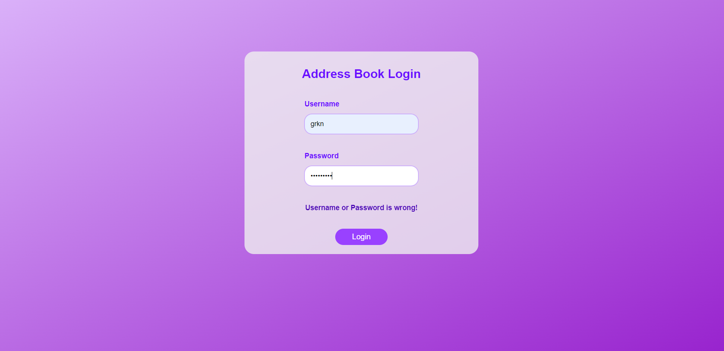
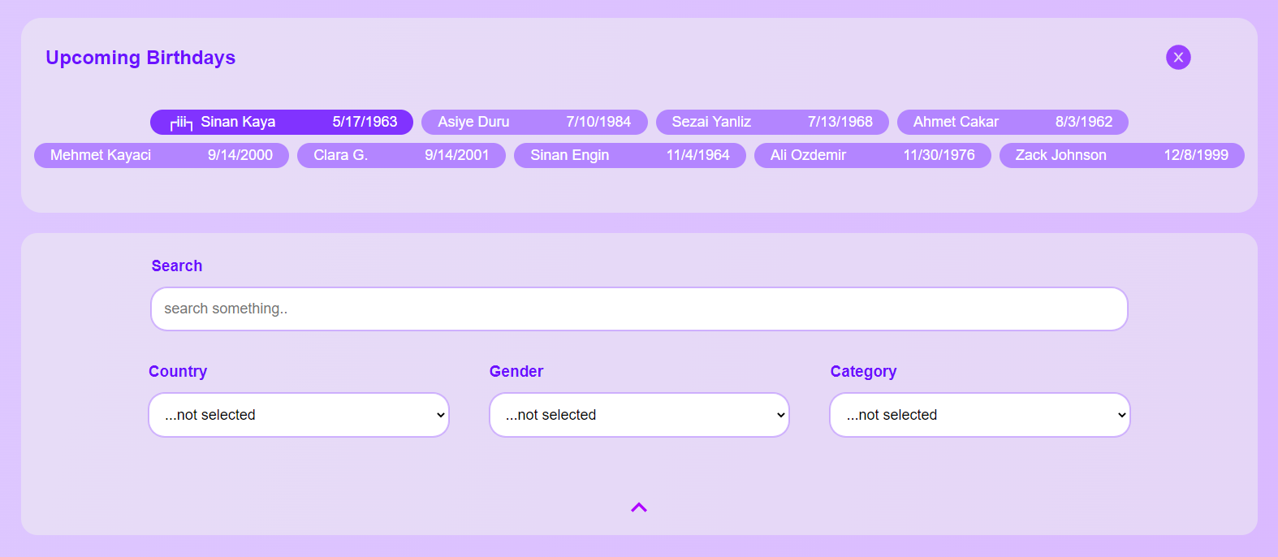
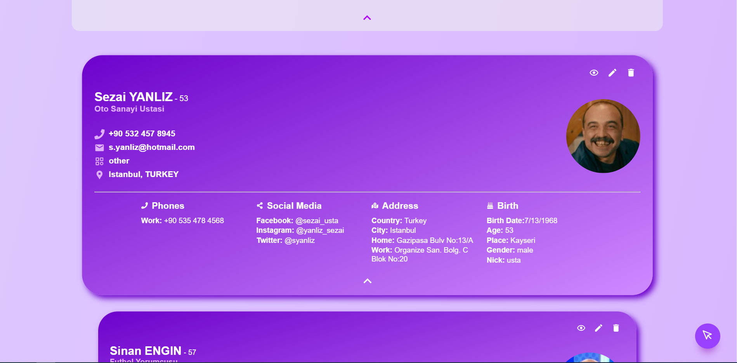
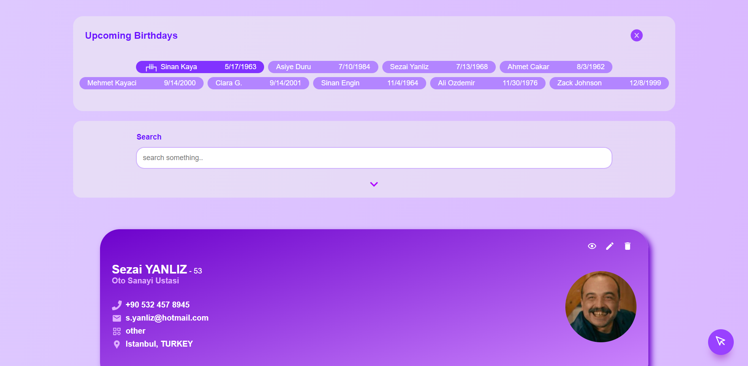
Screenshots

Slide 5
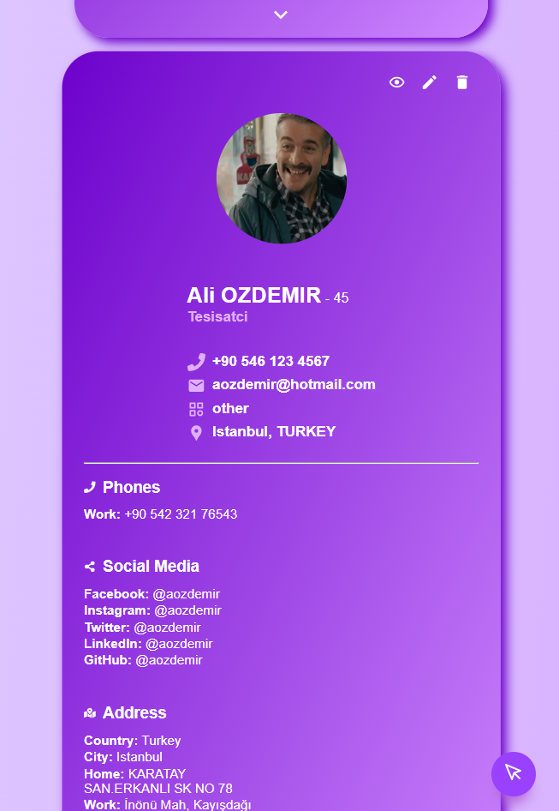
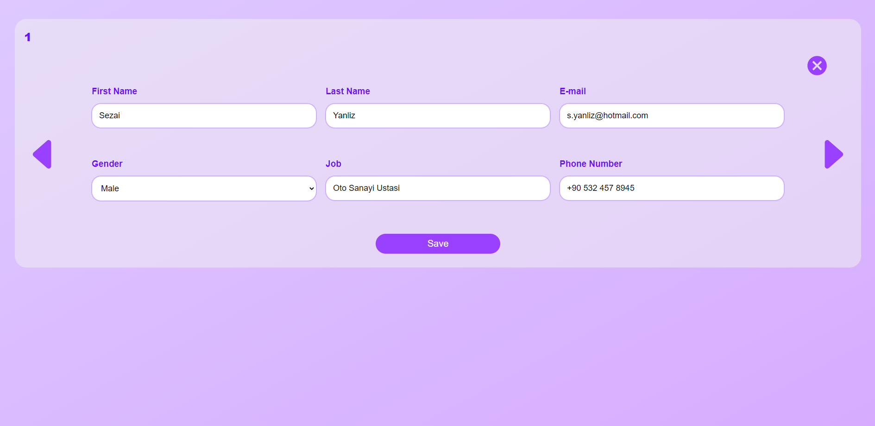
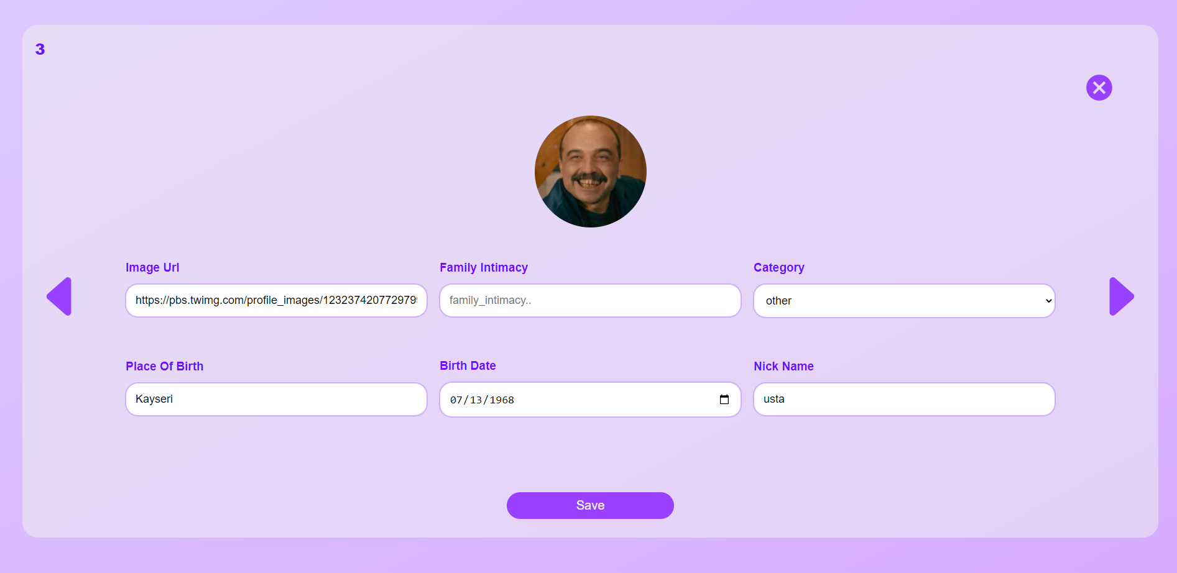
Screenshots

Slide 6
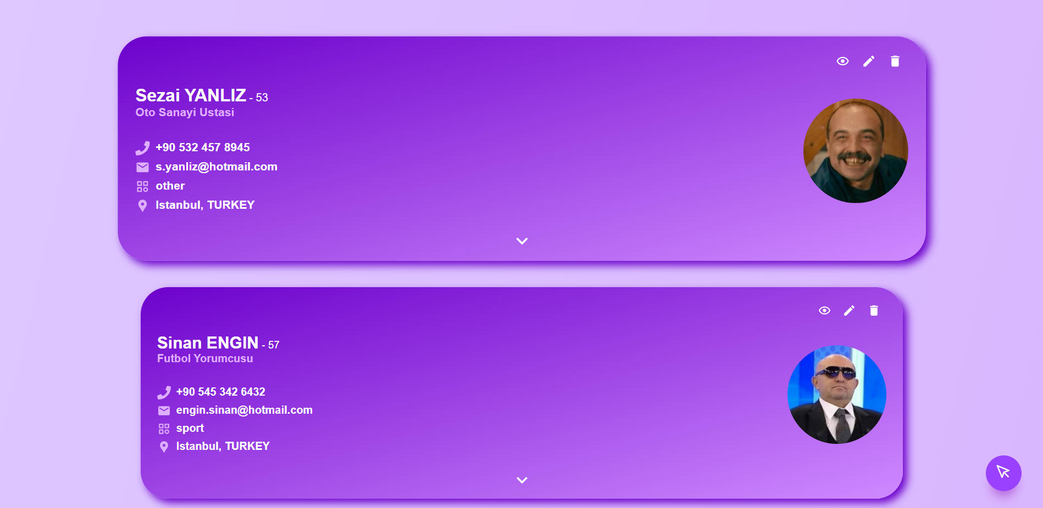
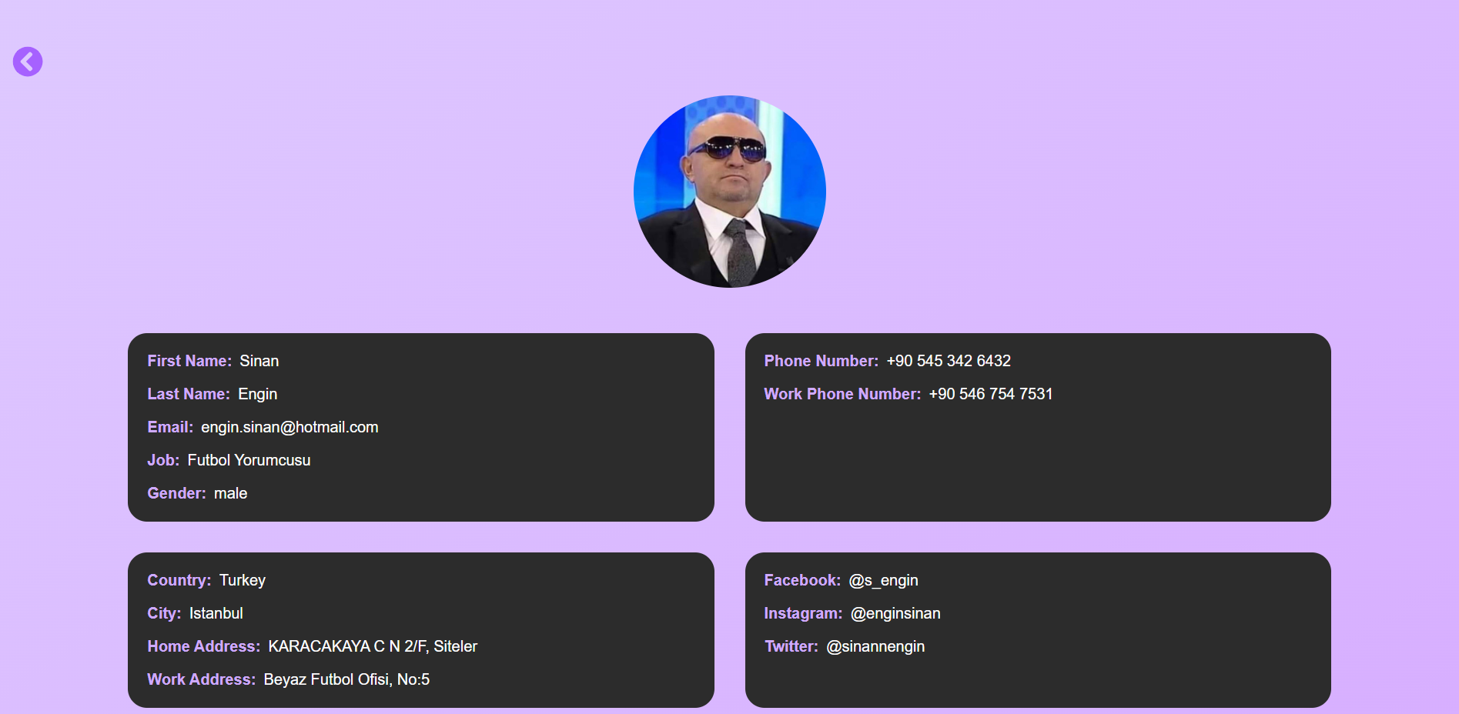
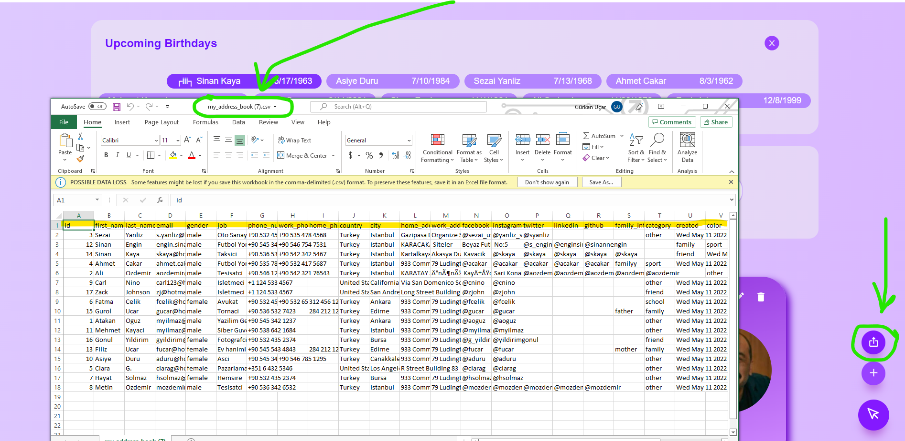
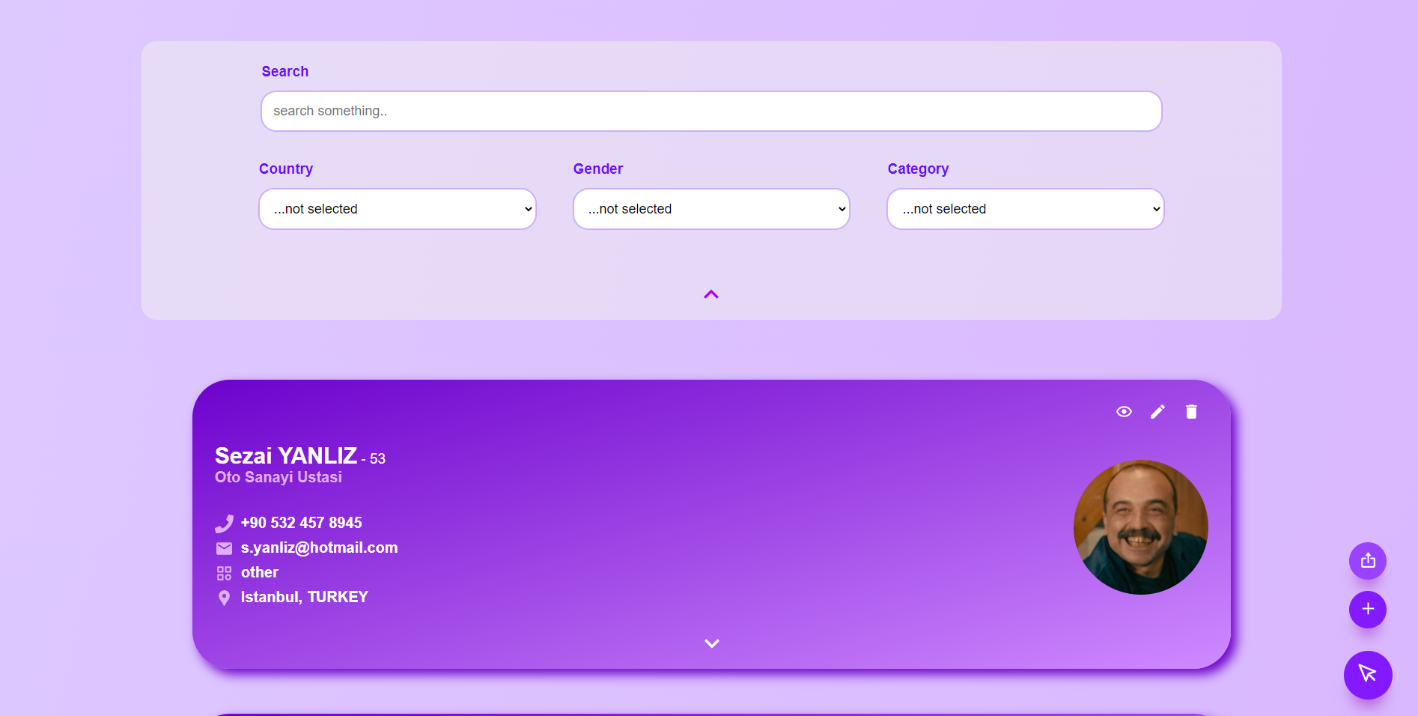
Screenshots

Slide 7
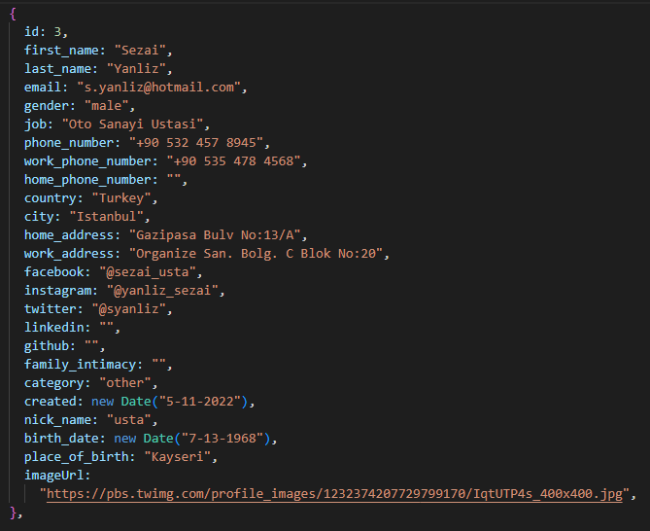
Sample Data

Slide 8
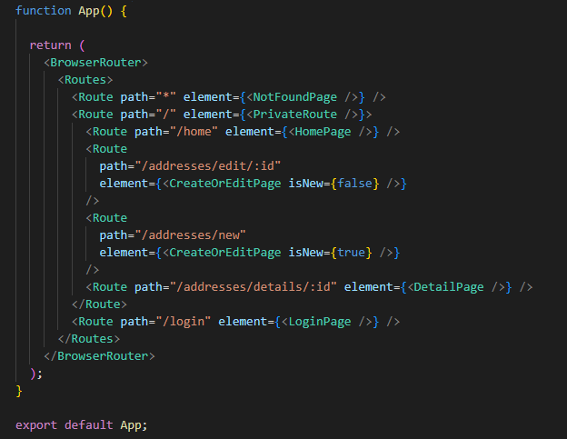
App.js and routes

Slide 9
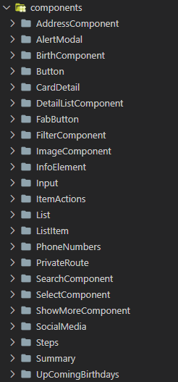
Other Components
Address Component: about address data
Alert Modal: alert modal for asking delete request
Birth Component: about birth data
Button: Reusable button
CardDetail: details about item
DetailListComponent: all info about item
FabButton: action button for exporting or creating new item
FilterComponent: manages filter
ImageComponent: reusable image component
InfoElement: each items in components title and value
Input: reusable input component

Slide 10
Other Components
ItemActions: delete, show or edit actions
List: address book list holder
ListItem: includes info about each data
PhoneNumbers: phone data
PrivateRoute: for authentication
SearchComponent: search box
SelectComponent: reusable select component
ShowMoreComponent: a toggle button for showing cardDetail of item
SocialMedia: social media data
Steps: step handler for update or create new item form
Summary: shows common data for each item
UpComingBirthdays: it shows to upcoming birthdays

Slide 11
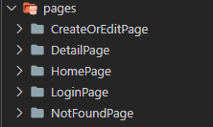
Pages
CreateOrEditPage: If isNew flag equals true, it will bring empty input fields. Otherwise, your data will find by the given id as a parameter and be set in inputs for changing.
DetailPage: It shows the details of item by given id.
HomePage: Includes list and filter components
LoginPage: Login for authentication
NotFoundPage

Slide 12
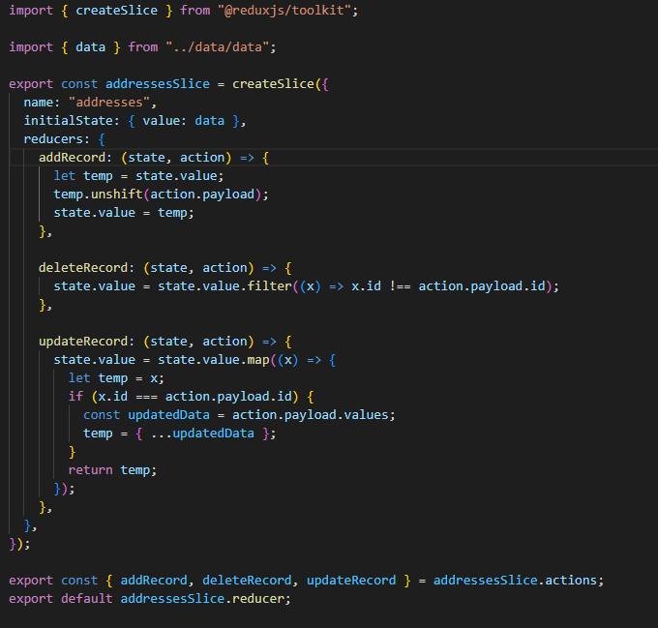
Redux Address Store

Slide 13
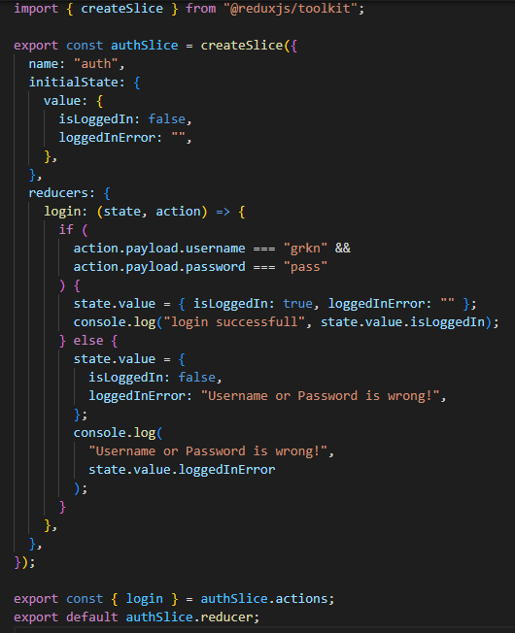
Redux Auth Store

Slide 14
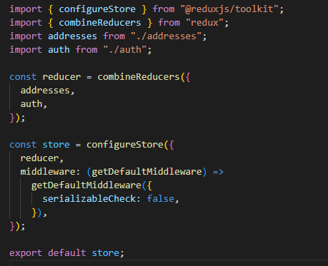
Index store

Slide 15
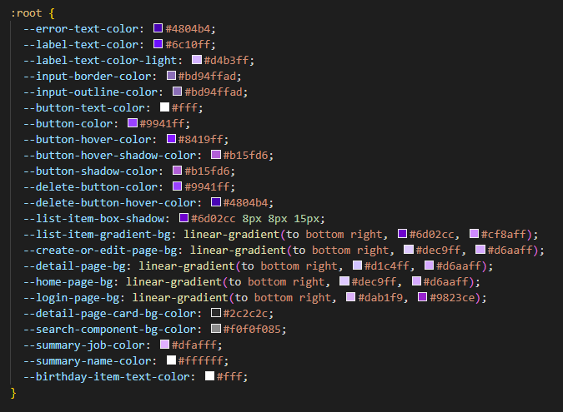
Global css variables

Slide 16
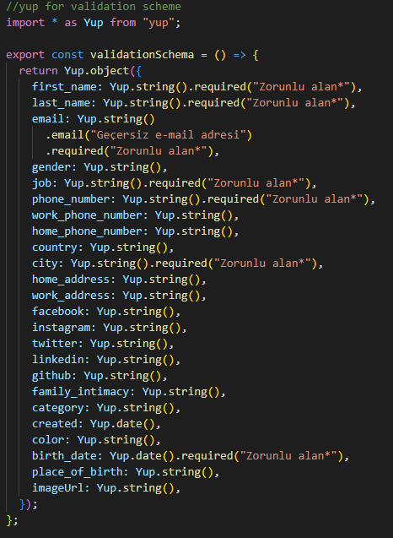
Input validation constraints

Slide 17
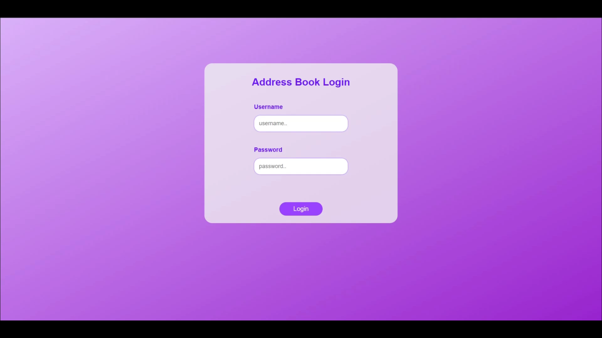
Video Example

